Slide 1
SCRUM
Læringsmål:
Kan bruge SCRUM og UP som projektmodel
Litteratur:
Scrum Guide-2011
Core-Scrum-Danish

Slide 2
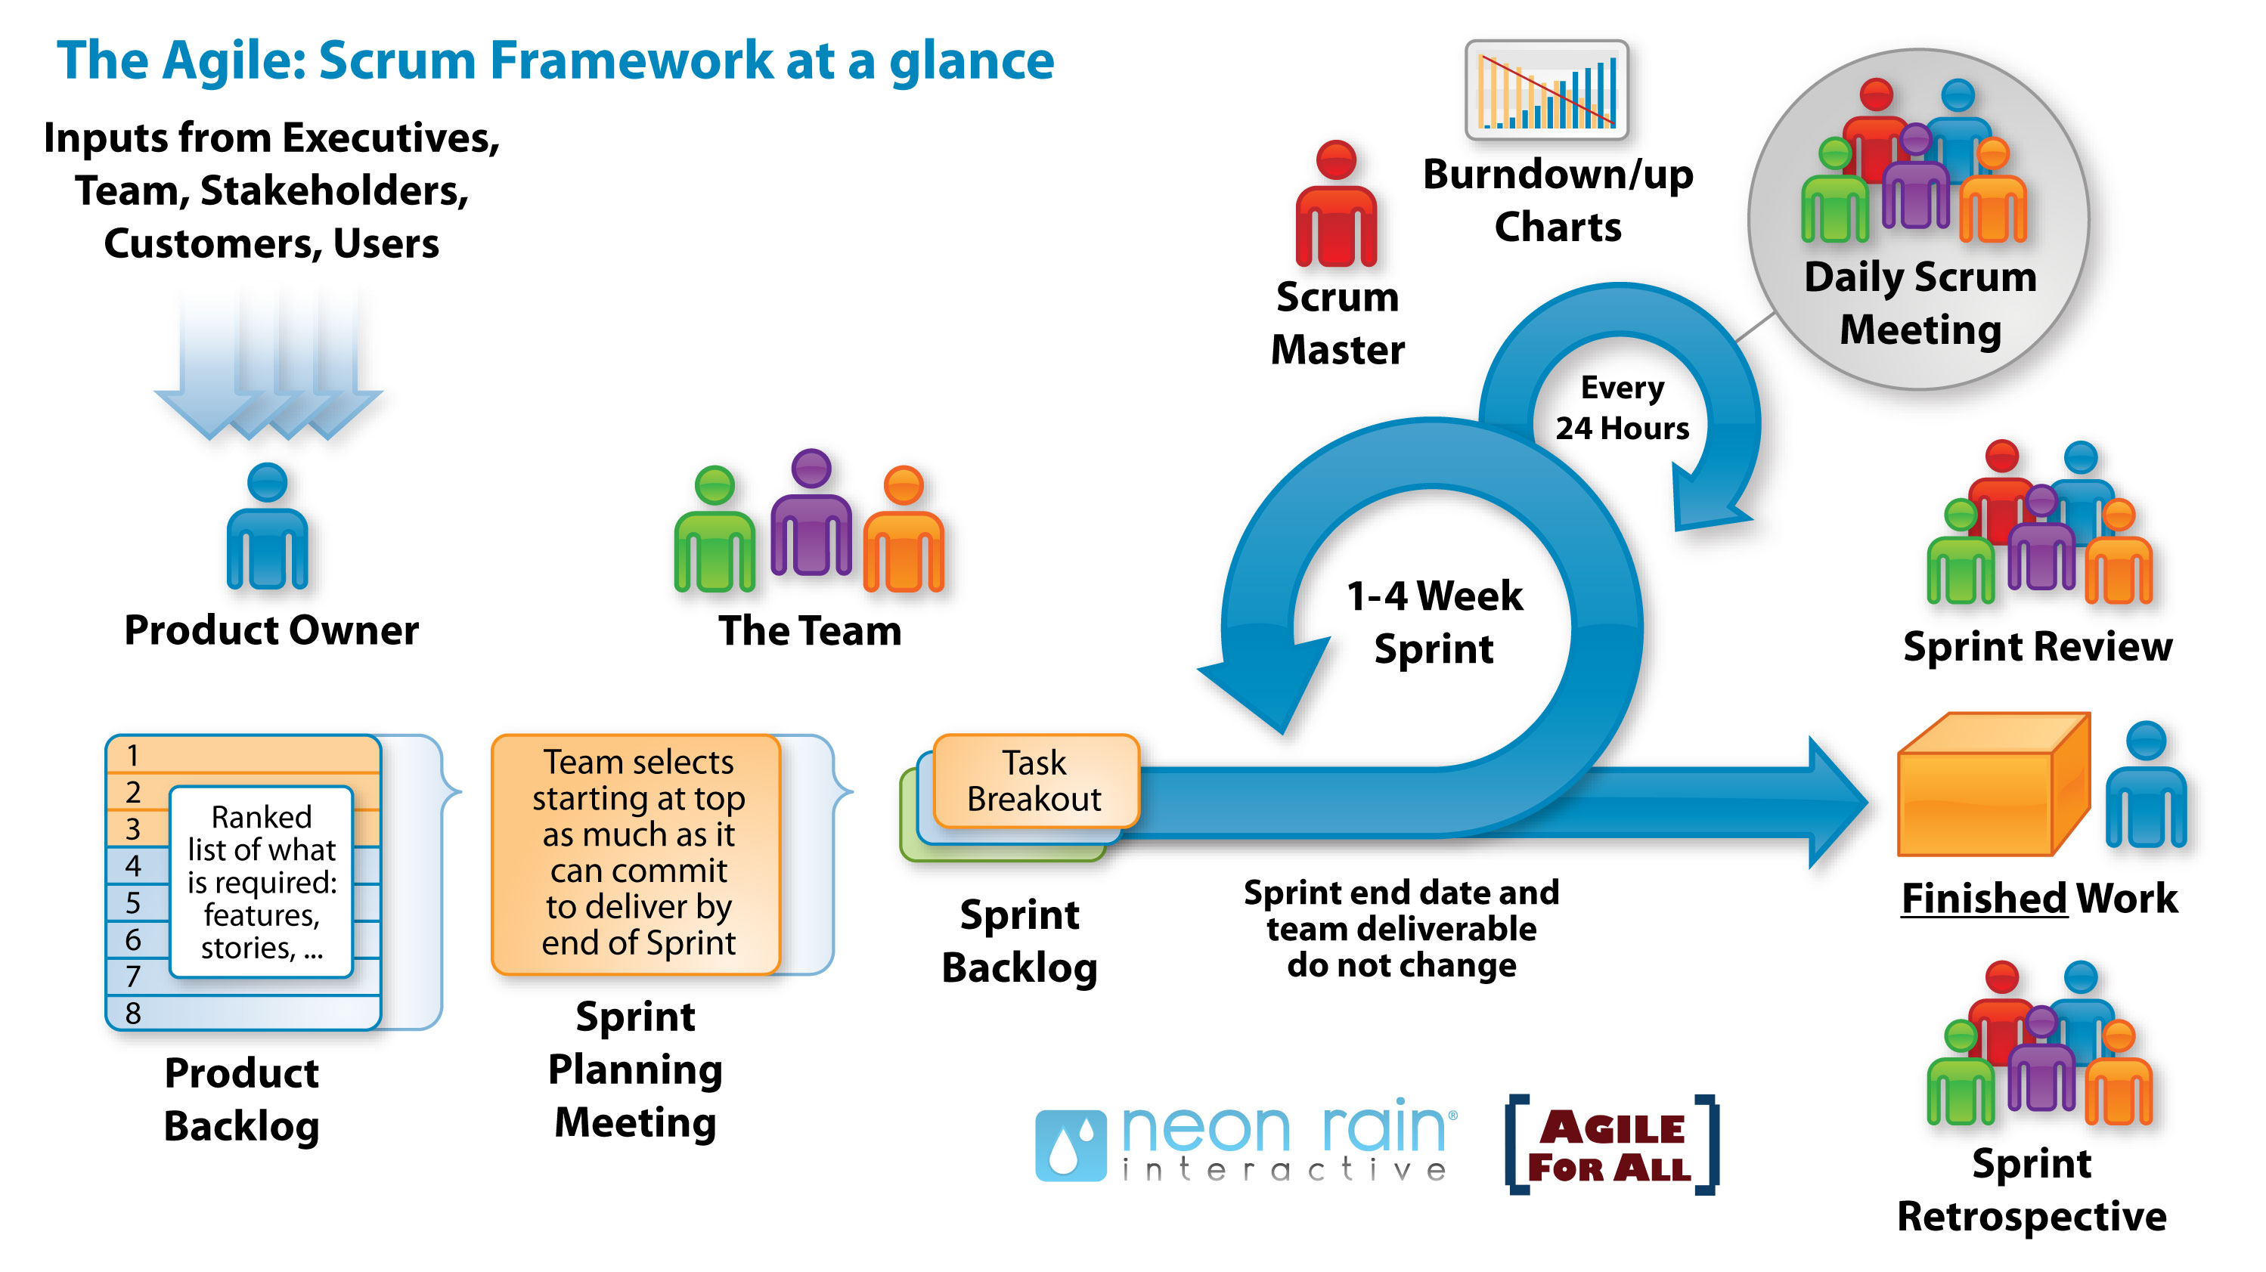
SCRUM, - product backlog samt iterationsindhold
Video: SCRUM-intro
http://www.agileforall.com/intro-to-agile/

Slide 3
Roller
Product Owner – repræsenterer ‘forretning’, business value + prioritering
Scrum master – beskytter team, SCRUM- proceskonsulent
Team

Slide 4
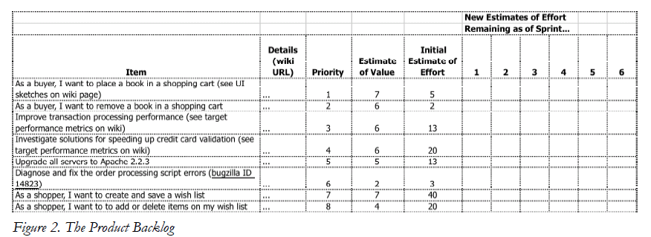
Product backlog

Slide 5
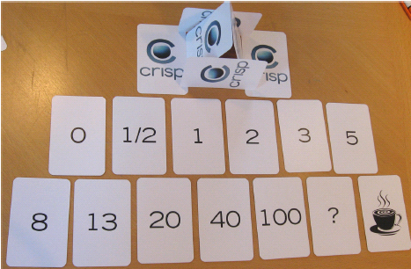
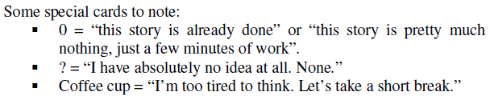
Planning poker (’fibonacci’)
https://www.planningpoker.com
Eller som manuelle kort
(Print eller skriv dem selv)

Slide 6
Planning Poker
Team members assign durations to tasks:
0, 1, 2, 3, 5, 8, 13, 21, 34, 55, 89
0, ½, 1, 2, 3, 5, 8, 13, 20, 40, 100
Team members turn over their estimates at the same time to avoid anchoring
Highest and lowest estimators get a soapbox
Repeat until consensus
Write down the task’s story points
Baseline story: All sizing compared to this
Velocity – The amount of work (story points) the team can do per sprint

Slide 7
Det handler om effort! Baseline Story
I estimere hvor svær og kompleks jeres item er. Dvs. det drejer sig ikke om timer.
Vælg en baseline story med værdien 3 eller 5.
Det skal ikke være den mindste værdi.
I vil kunne finde mindre stories.
Sammenlign med den.

Slide 8
Velocity
Team velocity is the rate at which a team delivers stories from the product backlog.
If you know your velocity, you'll have an idea about: How much value you've delivered until now (in story points and done user stories), and When you'll be able to deliver all user stories in the product backlog, and How many story points will you be able to deliver by a certain date.
How do we calculate velocity? Scenario: Our team delivers 3 user stories. The sum of the story points equals 20. Our velocity is then 20. If, in the next iteration, our team delivers 30 story points, then our average velocity is 25, or (20 SP + 30 SP) divided by 2 iterations = 25 SP.

Slide 9
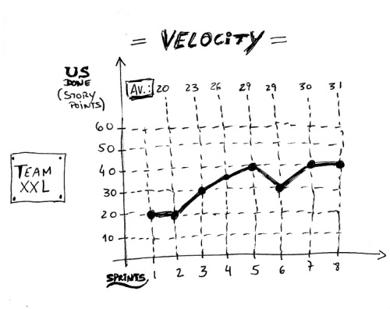

Slide 10
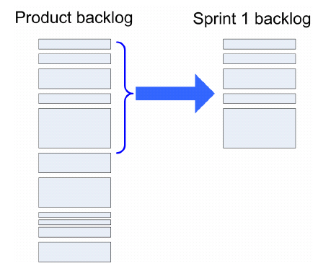
Sprint planning meeting

Slide 11
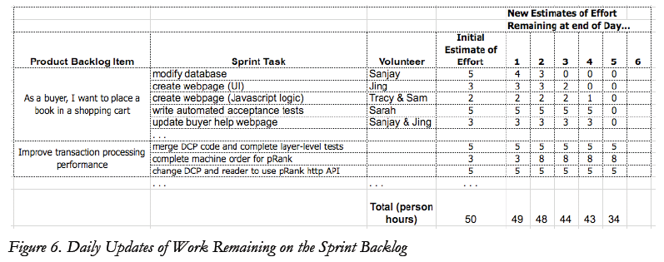
Sprint backlog
Nedbryd til ‘sprint tasks’
Se visualisering på næste plancher
Burndown data grundlag pr. dag.

Slide 12
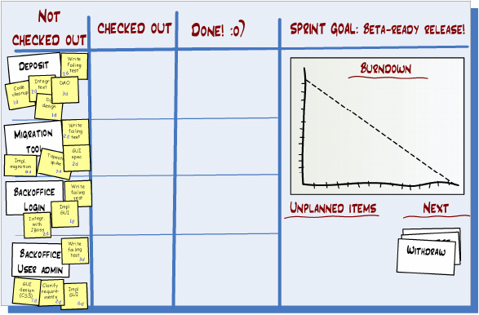

Slide 13
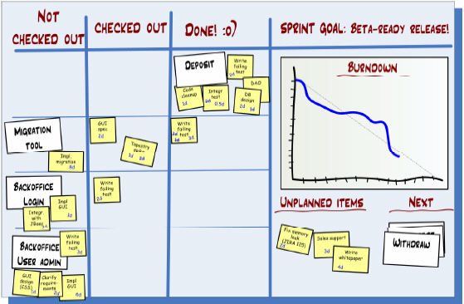

Slide 14
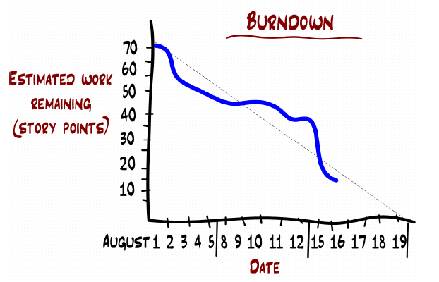
Sprint burndown chart
Velocity: Antal estimerings’points’ som teamet erfaringsmæssigt leverer pr. sprint
Synlig fremdriftsmåling via whiteboard.
DoD (!)

Slide 15
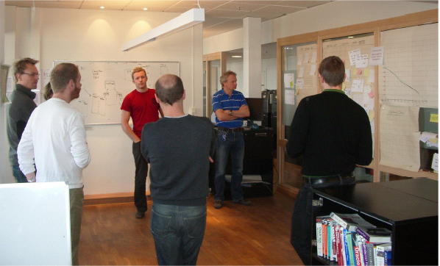

Slide 16
Definition of Done (DoD)
Skal beskrives for hvert item – Use Case eller del af Use Case
Ellers ved I ikke hvornår I skal flytte den til Done.
Kan f.eks. være en Unit test eller en manuel test.

Slide 17
Øvelse – Skal løses i grupper
SCRUM opgave på Fronter - Autofirma

